Slide 1
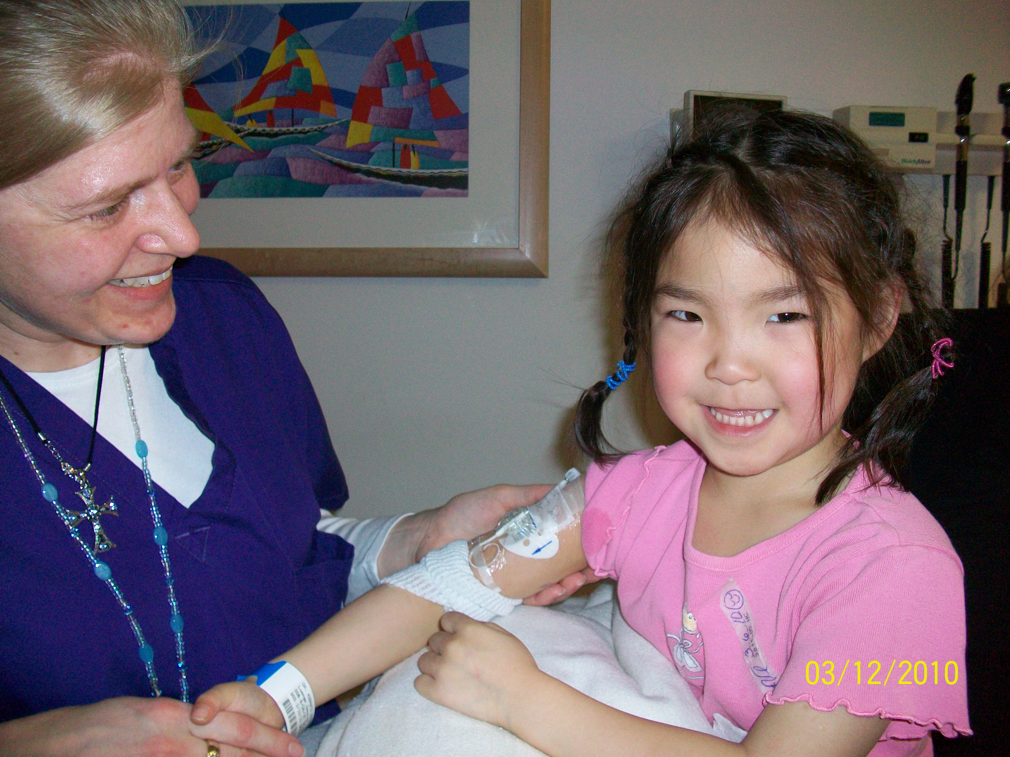
Collaborative PICC Line Placement Process
Paula Lamagna, BSN, RN, VA-BC, CPUI

Slide 2
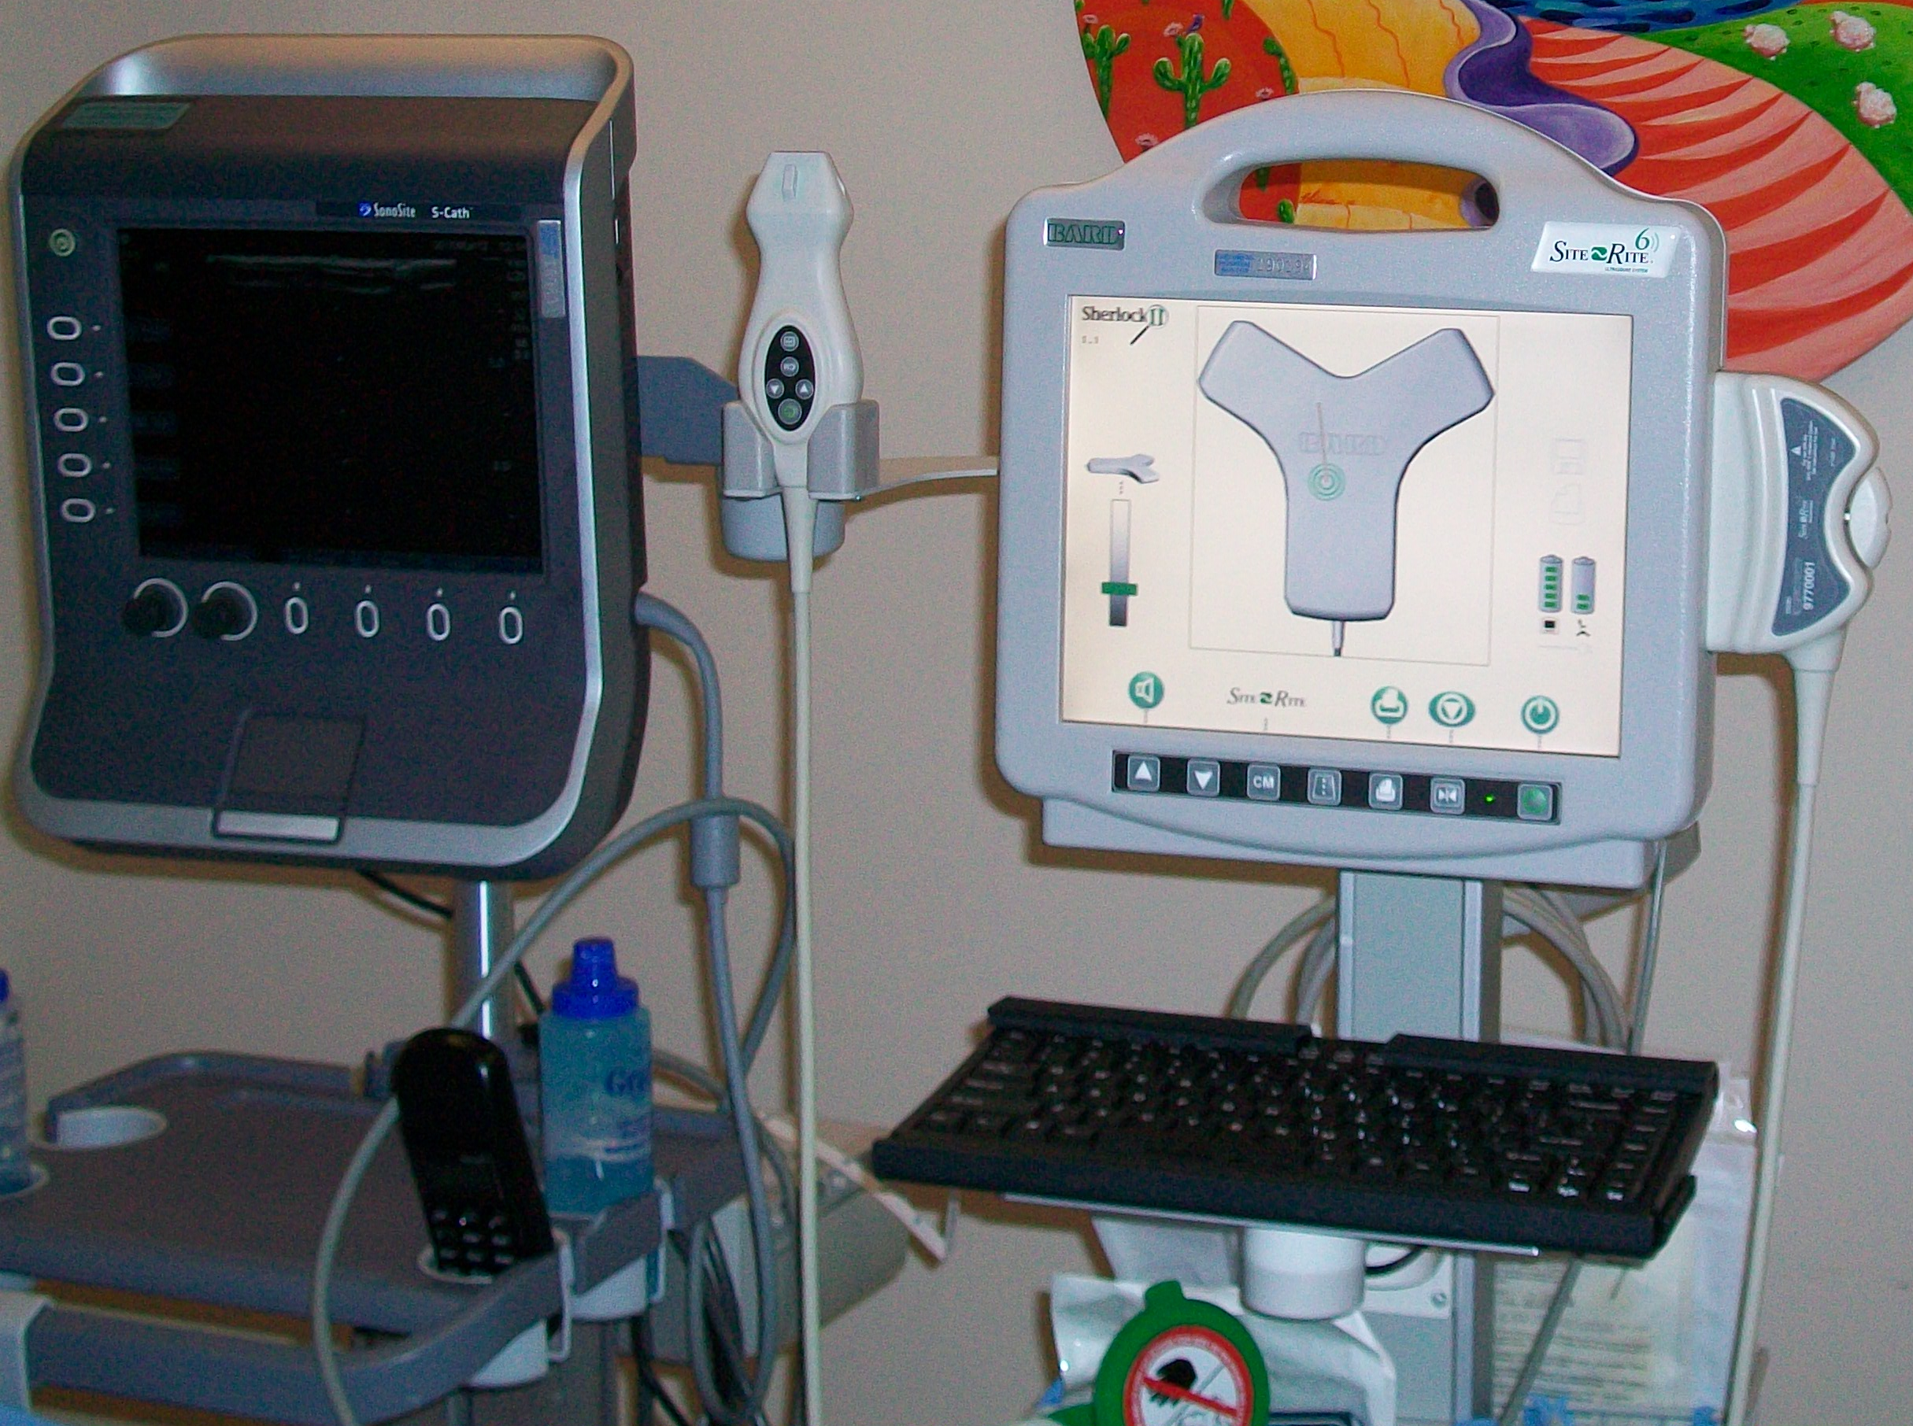
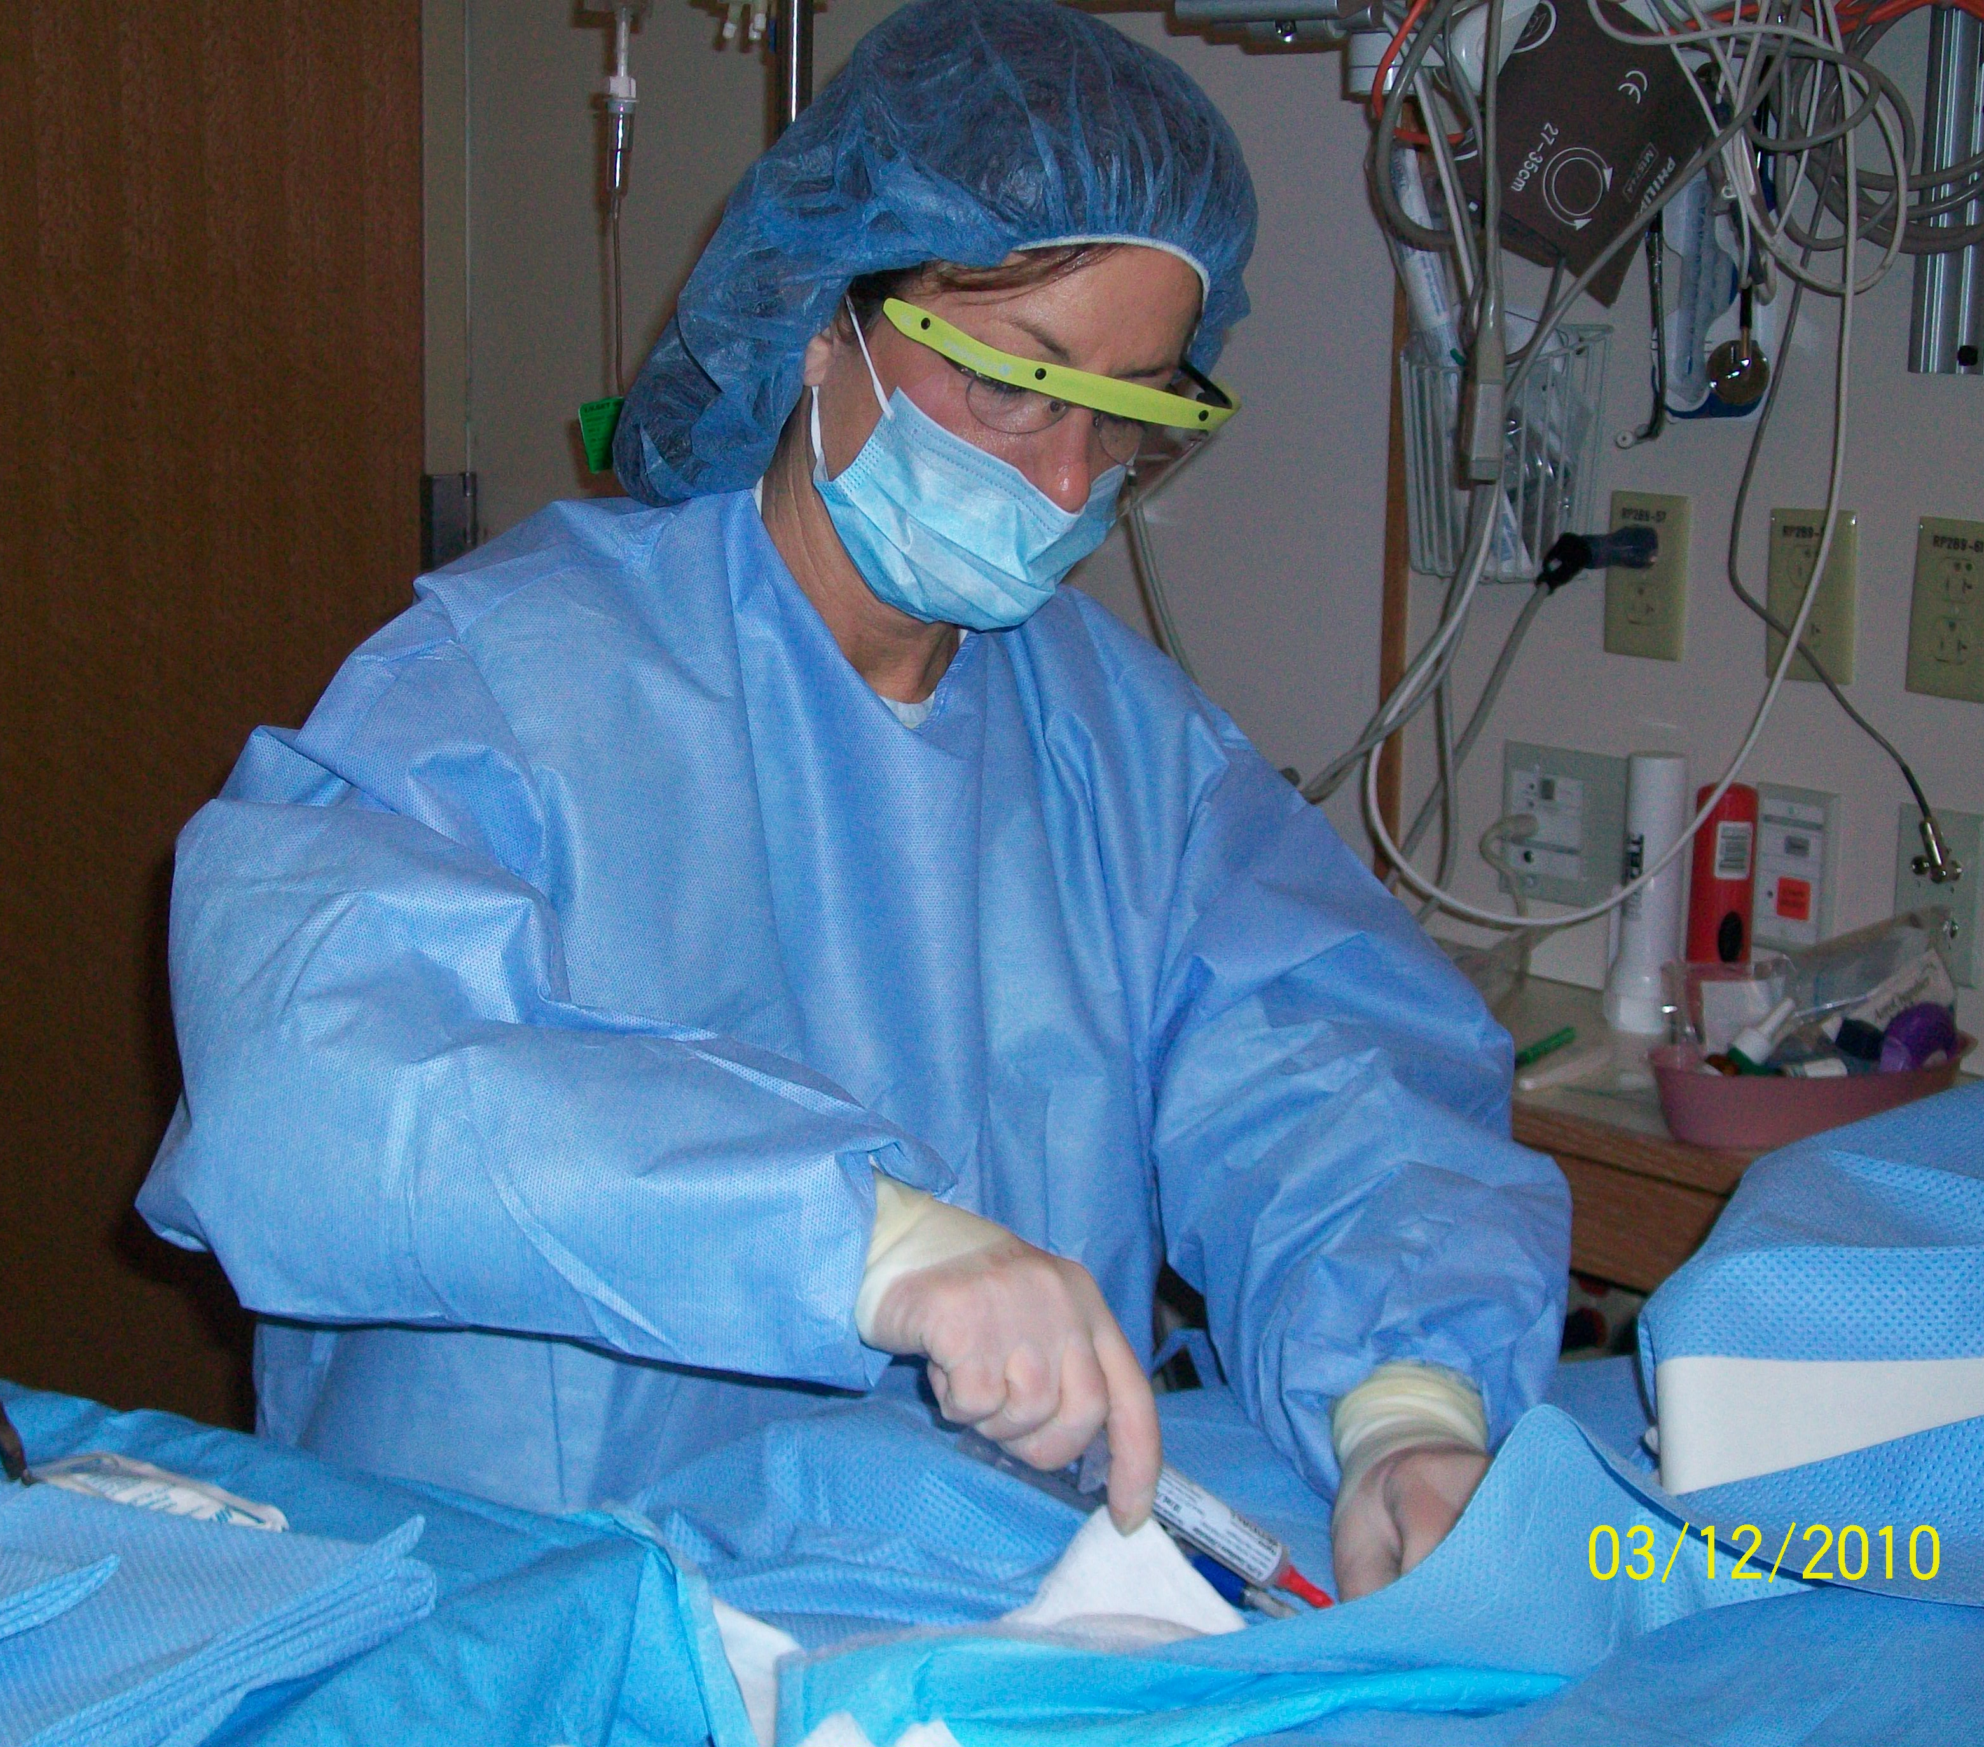
BCH IV Team : all RN team
9 Staff Nurses
6 RN’s placing PICC line
1 learning infant PICC placement, 1 learning PIV U/S and PICC placement
2 permanent night staff- not placing PICC’s
Nurse Manager
Management role

Slide 3
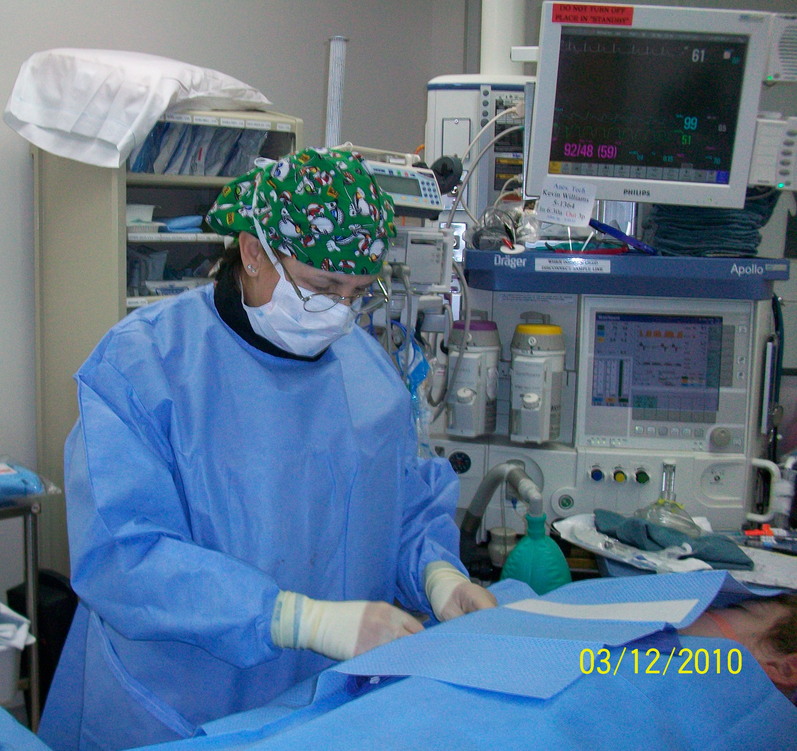
OR PICC Team
2 RN’s placing PICC lines with other scheduled procedures & PICC lines for inpatients not meeting sedation criteria Monday-Friday, IVT covers OR PICC’s on weekends

Slide 4
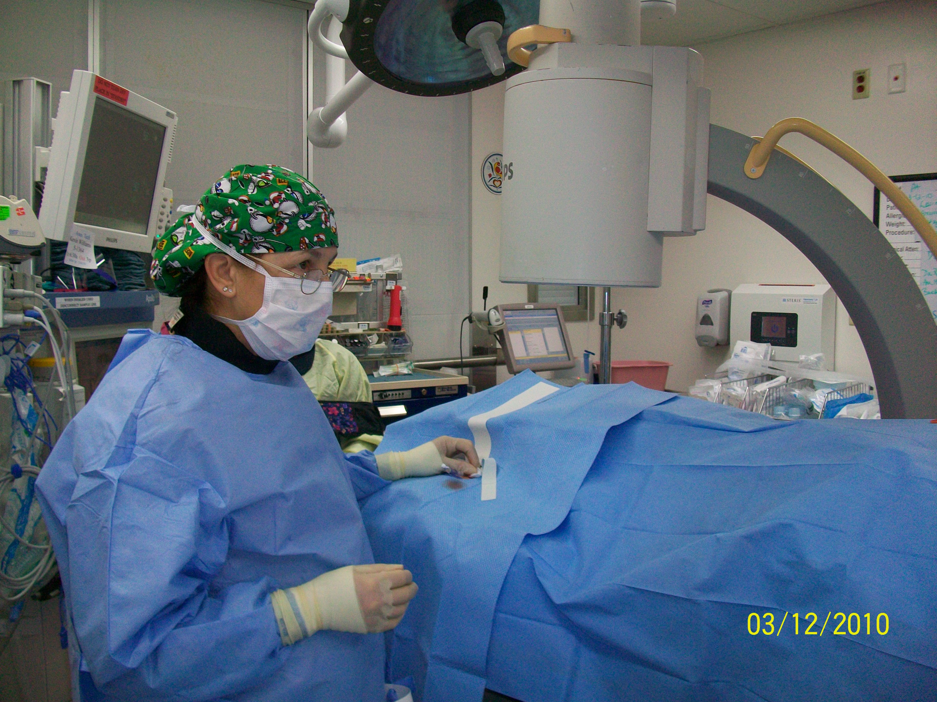
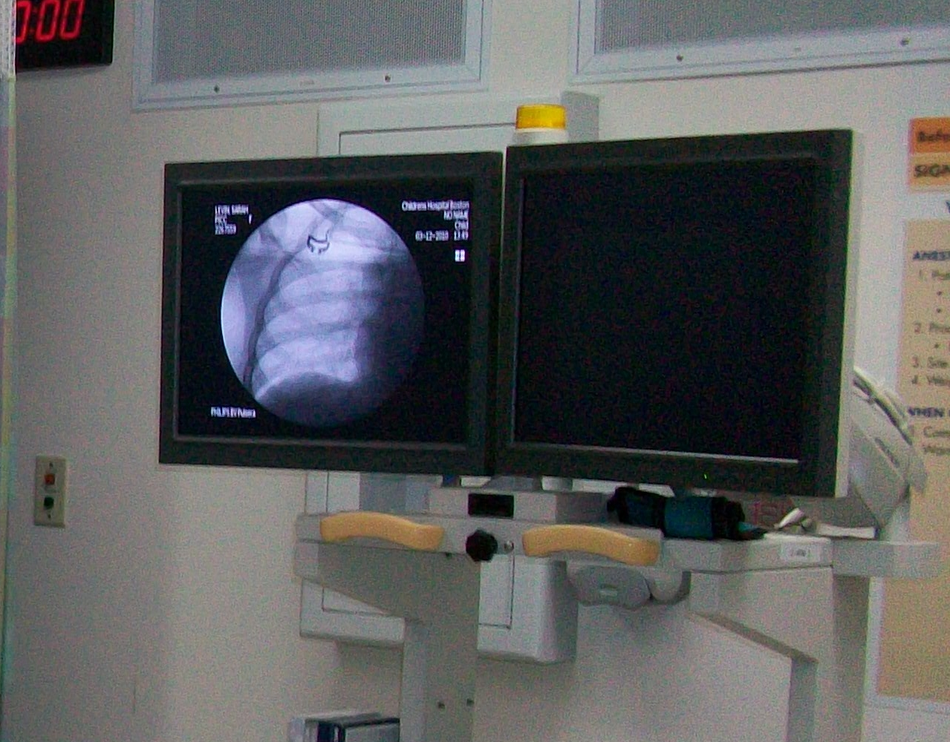
Interventional Radiology
IR: physician’s placing PICC lines with U/S and fluoroscopy

Slide 5
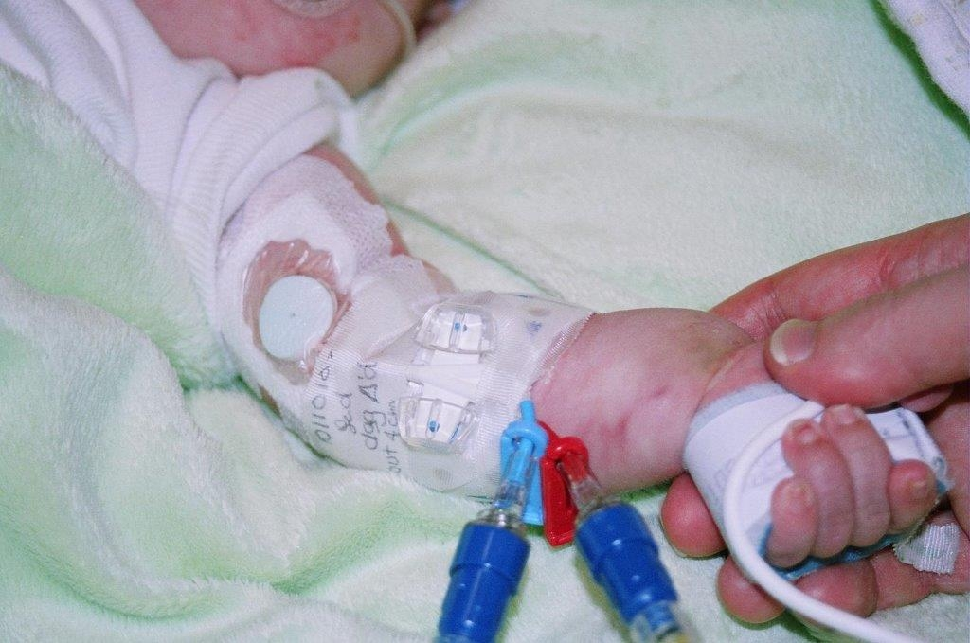
NICU
PICC lines placed by NP, physicians, IV Team
NICU lines 1.9f single, double lumen
Tools…..
Role of NICU bedside RN
Prioritizing
When to call IVT

Slide 6
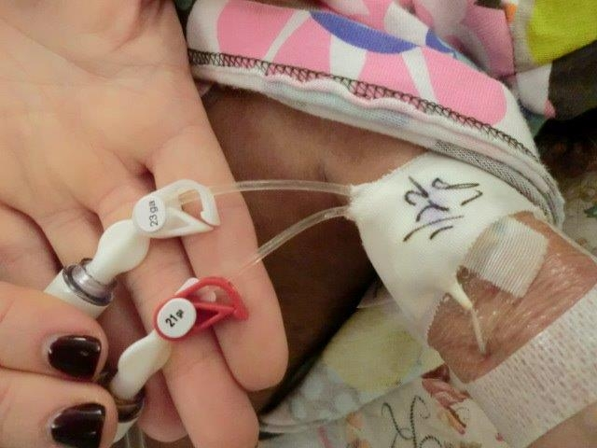
Neonatal ICU
NICU physician’s & NP’s place PICC lines
IVT PICC’s using u/s & MST pt’s > 1.5 kg, no MST < 1.5 kg
Notes:
NICU staff: no u/s, no MST technique

Slide 7
Request for PICC line to IV team pager
Request reviewed by IV team staff: age, diagnosis, plan includes bedside placement, or alternate location
IR:
MD/Fluoroscopy
OR:
PICC RN Team
Outpatients:
Consult PICC Hospitalist
placed by IV Team in Gastro-procedure Unit
NICU: NICU staff MD’s and NP’s or
IVT Consult prn
Notes:
Request for picc line to IV team pager
Request reviewed by IV team staff: age, diagnosis, plan includes bedside placement, sedation, OR, or IR
OR: PICC RNs in OR staffing model, covered by IVT on weekends/holidays: fluoro/X-Ray
IR: referred for anatomical issues (threading), previous history or failed bedside attempt.
Nicu: Nicu staff MD’s and NP’s – consult IVT for placement depending on pt need: DL, drawing line, unsuccessful attempt
Outpatients: Discuss PICC Hospitalist (medical MD attending – rotates through group of MDs). PICC placed by IV team in gastro-procedure unit with or without sedation based on pt need.

Slide 8
PICC Procedures
Year | NICU | IVT | GPU | IR | OR
2010 | 24 | 1086 |  |  | 238
2011 | 31 | 997 |  | 316 | 260
2012 | 42 | 1129 | 136 | 321 | 341
2013 | 43 | 1008 | 125 | 296 | 358
2014* | 30 | 908 | 158 |  | 264
Notes:
2010/2011 IVT data includes GPU cases – didn’t start tracking separately until 2012. GPU PICCs are placed by
Other than 2011 – slightly variable trend in IVT PICC placement volume - 14% increase 2012, slight decrease in 2013 and trending approx 10% increase 2014
Yearly Stats 2010- 2014
PICC team: 800-1000 PICC line placements
OR 300 PICC line placements
IR 300 PICC line placements
NICU PICC line placements by IV team 24-42

Slide 9
PICC Procedure Volume
* YTD July 2014

Slide 10
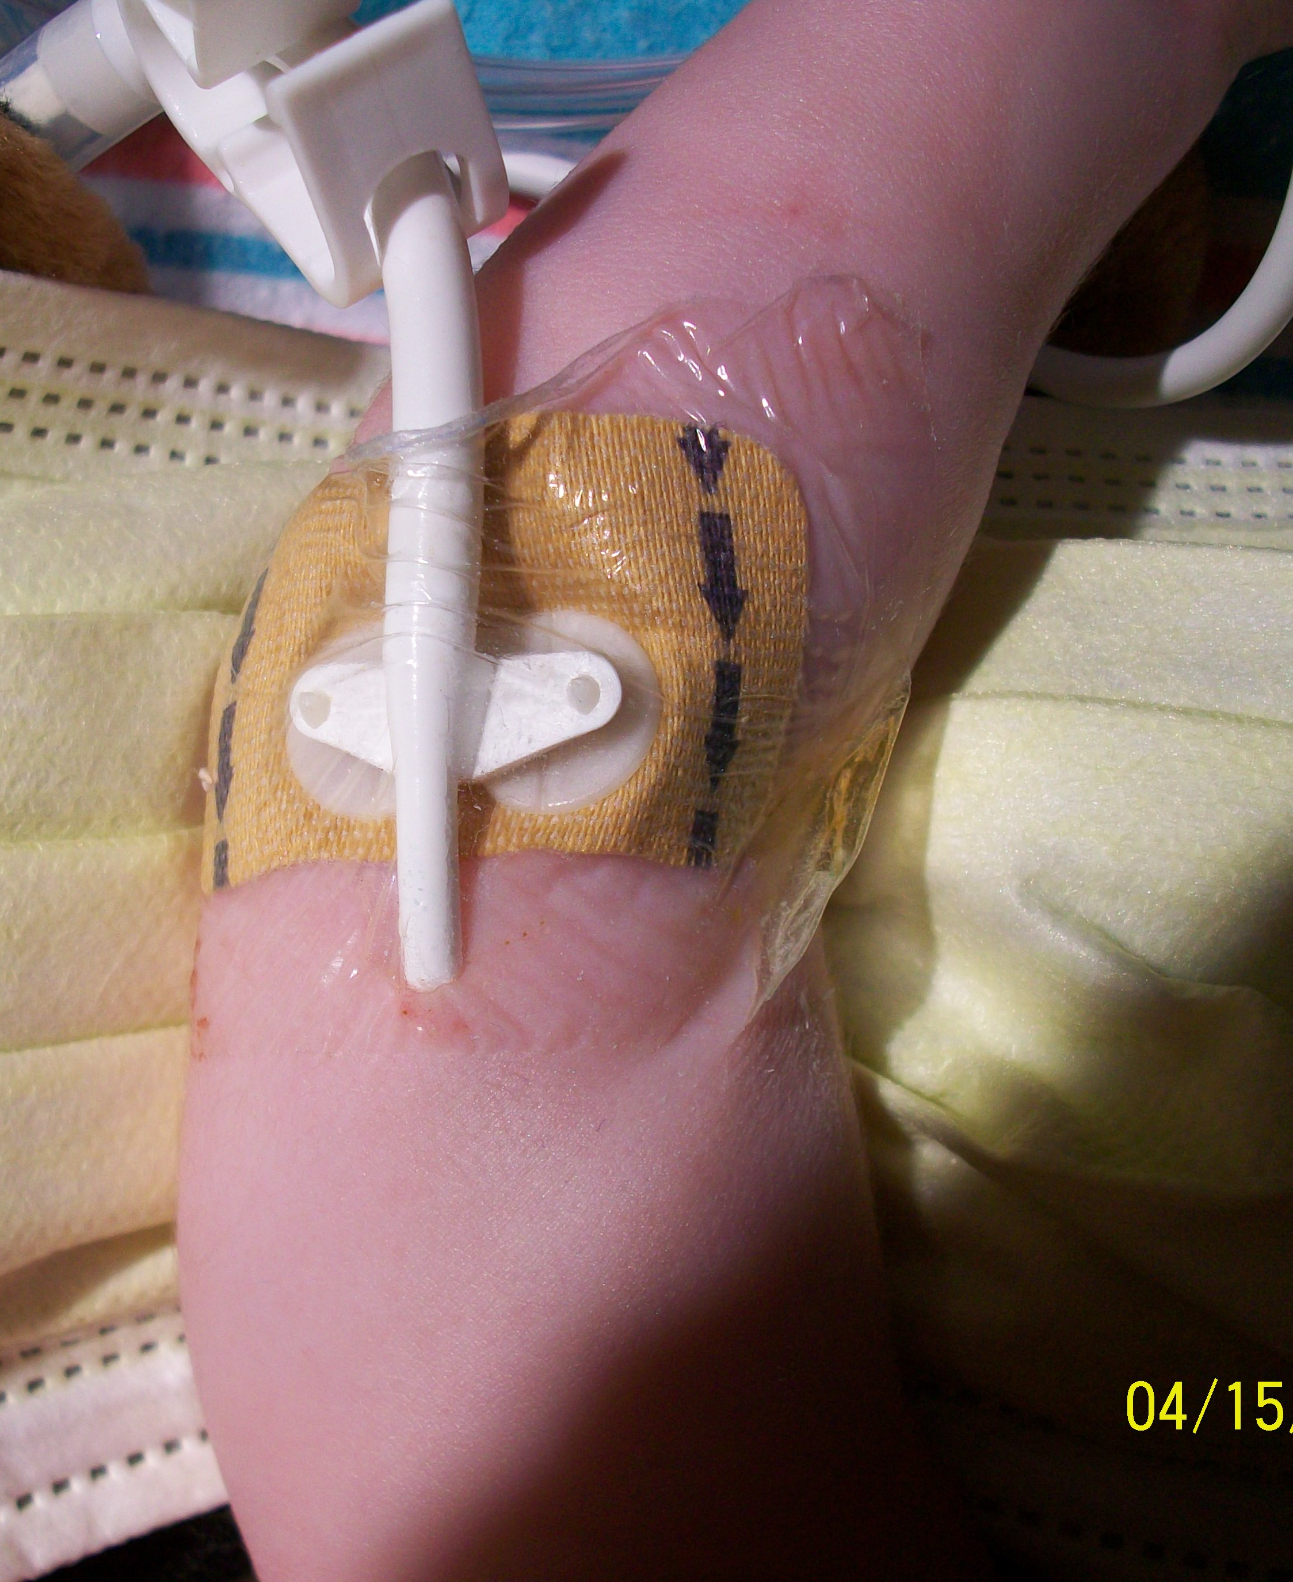
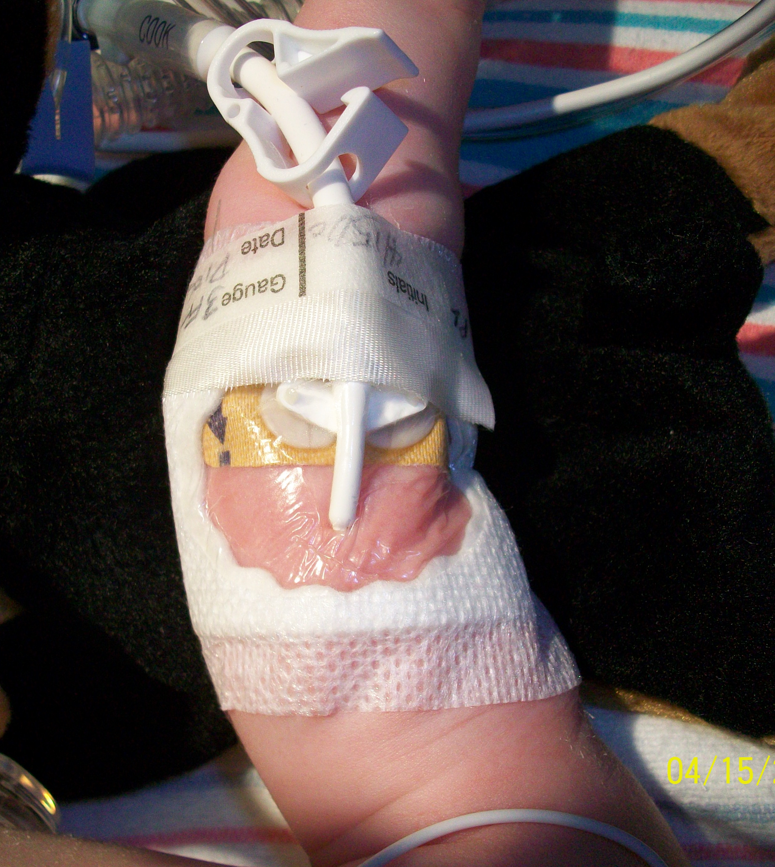
Complications
Line migration
Dressing integrity

Slide 11
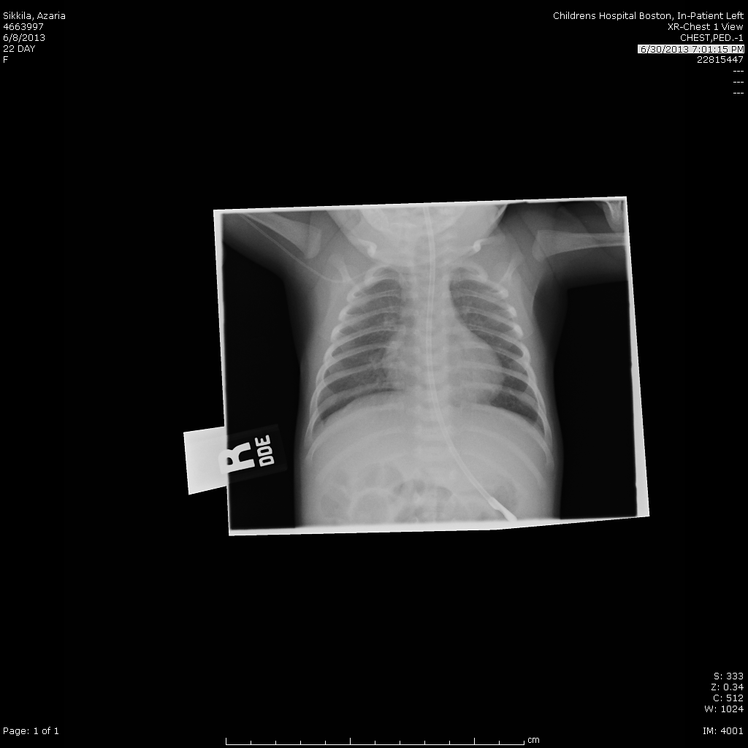
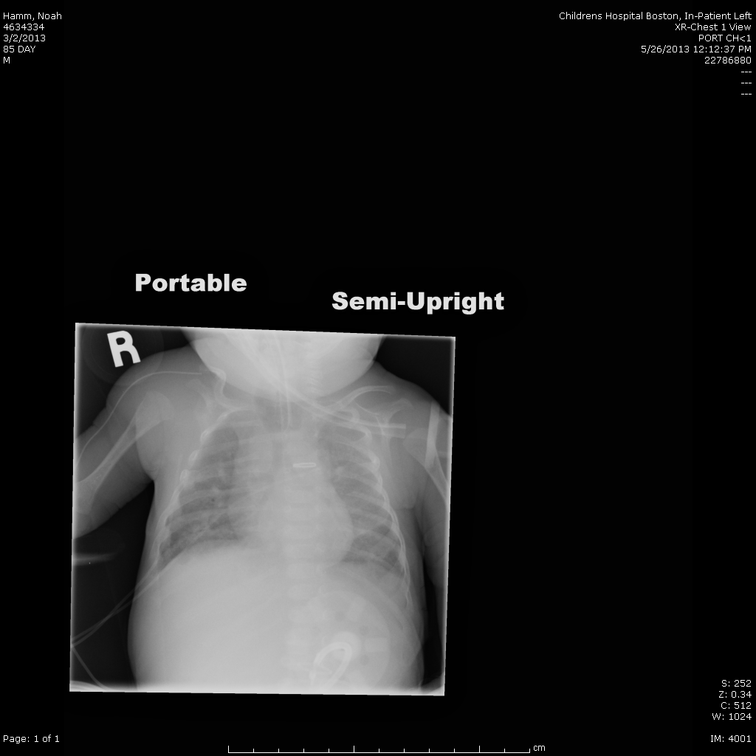
Complications
Tip Migration
PICC no longer central, terminating in right axillary/subclavian vein junction
PICC no longer central, terminating in right axillary/subclavian vein junction
PICC terminates in the SVC

Slide 12
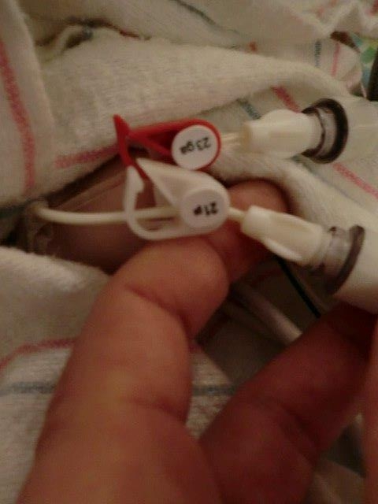
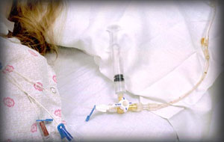
Complications
Catheter Occlusion

Slide 13
Quality Improvement
Bundles
PICC dressings
Safety Event Reporting System (SERS)
Monthly review
Wait Times
Notes:
Insertion Bundle – per IHI recommendations
PICC dressings – IVT changes all on patients < 1 year: instituted due to line migration in infants
SERS – VOLUNTARY reporting system – we know that we don’t capture all events. Monthly review of events at PICC SME (subject matter expert group)
IVT Wait times vary widely due to pt. need, plan (multifactorial): range 1:45 hour to 3 days. Average is about 1.5 days

Slide 14

"If everyone is moving forward together, then success takes care of itself." - Henry Ford
Notes:
Talk about collaborative efforts to meet patient/family needs

Slide 15

Questions

